Slide 1

Police Use of Force Policies
Natural Language Processing Analysis
November 2020
Notes:
David

Slide 2
Agenda
Agenda & Table of Contents
1
5
Introduction
Advanced NLP Analysis
2
6
Approach
Questions
3
7
Overview
Implications
4
8
Basic NLP Analysis
Appendix
Notes:
David

Slide 3

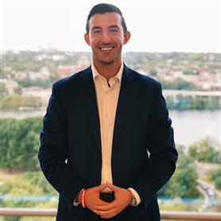
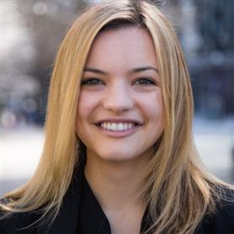

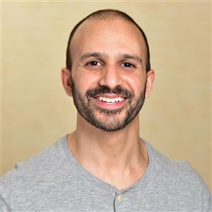
Introduction: The Team
INTRO
Our team brings together analytical thinking, policy expertise, NLP experience, and Python programming capabilities.
David Kersey
Pythonista
Justin Schulberg
Viz Whiz / Git Guy
Kennedy Patterson
Analytics Strategist
Francesco Tinelli
Data Ingestor
Nasser Qadri
NLP Oracle
Background:
Business Analytics
Current Project:
Con Edison, Fraud Analytics
Role on Team:
NLP Analysis, Model Development
Background:
Data Analytics, Engineering, Visualization
Current Project:
Department of State, Visa Office Analytics
Role on Team:
NLP Analysis, Visualizations, Git
Background:
ETL, data visualization, cost modeling
Current Project:
Air Force FIAR
Role on Team:
NLP Analysis
Background:
Data Analytics and Visualization
Current Project:
CBP AMO Budget
Role on Team:
PDF/Text Scraper
Background:
Data Science
Current Project:
Department of State, Center for Analytics
Role on Team:
Mentor on all things analytics, strategy, and NLP
Notes:
Everyone!

Slide 4
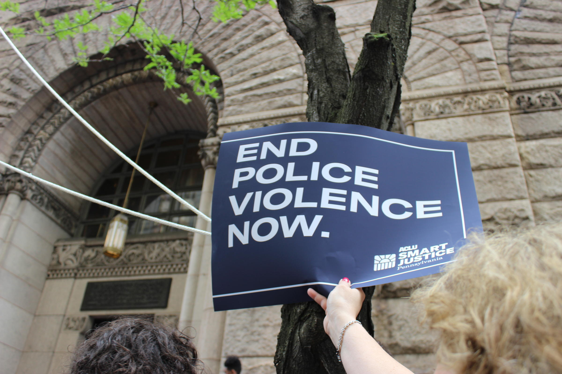
Introduction: The Project
INTRO
How does language in Police Use of Force policies differ between major US cities? Does language in these policies affect outcomes in trends related to police-caused fatalities?
The results of this project/case study will:
Compare and determine the similarity of language used in Police Use of Force policies across major US cities
Analyze most frequent words and topics within Use of Force policies
Identify specific language that led to positive and negative use of force outcomes
Provide suggestions for changing language in Police Use of Force policies
Notes:
Justin

Slide 5
Our Approach
Approach
When approaching this project, we went through three phases: data collection & pre-processing, basic NLP analysis, and more advanced NLP similarity analysis.
Data Collection & Pre-processing
Basic nlp analysis
Advanced nlp similarity analysis
Collect Use of Force policies from 100 largest police departments in U.S.
Scrape text from policies, including PDF scraping techniques for policies in PDF format
Normalize, tokenize, and lemmatize text
Removal of stop words and insignificant words
Key text summary statistics, including:
Number of documents analyzed
Total words across all documents
Average words per document
Word frequencies
Bi-gram analysis
Topic modeling to identify recurrent themes amongst successful policies
Cosine similarity to quantify language similarity between policies in 100 cities to an "ideal policy"
Notes:
Kennedy

Slide 6
Policy Text: 5,000-ft Overview
overview
Before diving into the NLP analysis, our group gained a deeper understanding of the type and scale of the documents we were analyzing.
TOTAL POLICIES ANALYZED
TOTAL NUMBER OF WORDS
% OF NON-STOP WORDS
AVG WORDS PER DOCUMENT
More than
39
99.5%
386, 141
words
Although our team tracked about 100 Use of Force policies across the country, we were only able to successfully scrape the contents of 39 policies.
Across all 43 documents, there were 386,141 words. These documents are long!
The vast majority of words did not constitute stop words in the policies analyzed.
On average, a police Use of Force policy analyzed by our group contained 8,980 words.
Challenges faced included policies being uploaded as scanned PDFs and peculiar formatting of documents
The longest policy belongs to the Police Department of Austin, TX
Stop words included words like ‘and’, ‘to’, ‘must’, ‘shall’, ‘have’, ‘from’, etc.
Note: Length of document does not necessarily correlate to completeness of policy
Notes:
Justin
Gloss over stop words

Slide 7
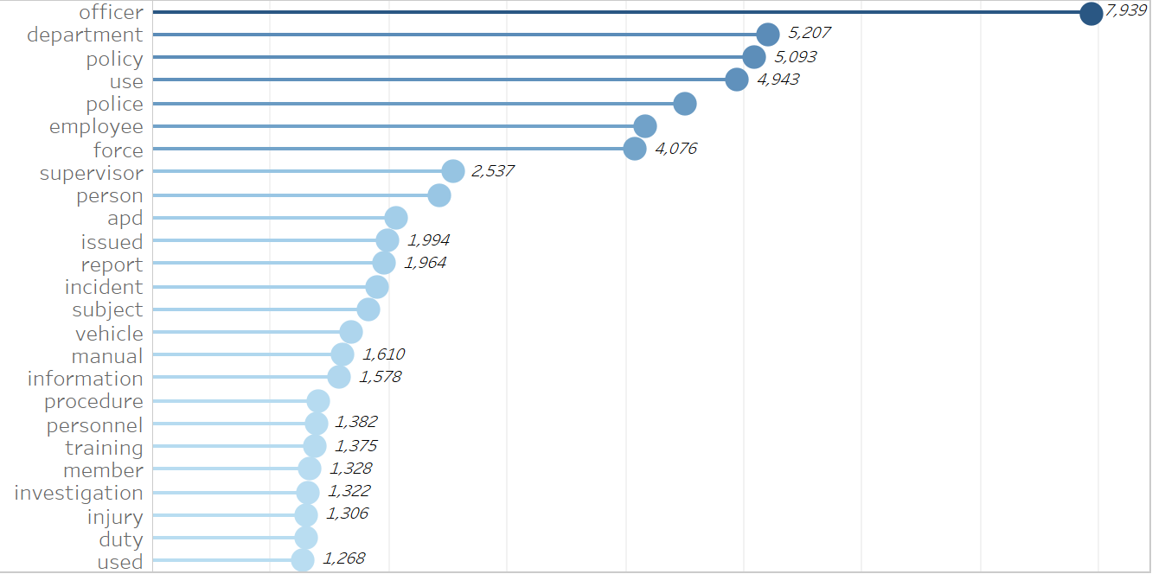
Basic NLP Analysis: Word Frequencies
Basic NLP Analysis
Our team analyzed the word frequencies across all documents. Below is a subset of the top 25 words.
Notes:
Justin
Keep this to 15-20 seconds

Slide 8
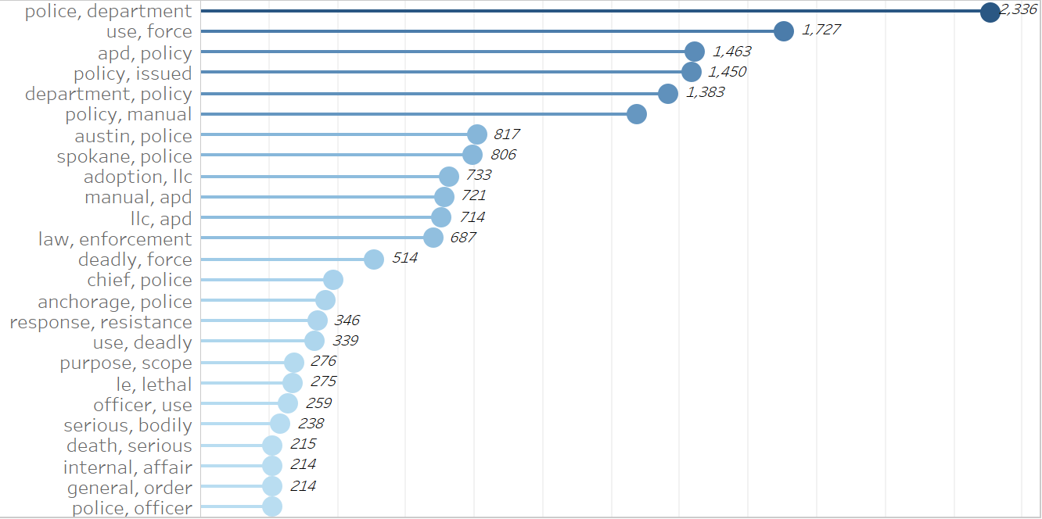
Basic NLP Analysis: Bi-grams
Basic NLP Analysis
Our team analyzed the frequencies of 2-pairs word combinations, across all documents. Below is a subset of the top 25 bi-grams.
Notes:
Justin
Keep this to 15-20 seconds

Slide 9
Advanced NLP Similarity Analysis: Introduction
Advanced NLP Analysis
Our team analyzed use of force policies in 100 cities along eight critical margins defined by Campaign Zero to drastically reduce violent outcomes
Overview: Campaign Zero compared use of force policies to police violence data in the 100 largest US cities and found eight key inclusions in Use of Force policies associated with reduced police killings
Objective: Create a model that detects language associated with these eight key inclusions to assess how closely a city's use of force policy resembles the "ideal policy"
8 key policies are associated with drastic reductions in police violence ¹
“Police departments with 4 or more of these restrictive policies had the fewest killings per population per arrest” ¹
“..a police department that has all eight of these policies has 72% fewer killings than a police department with none of these policies in place.” ¹
1. Source: Campaign Zero Limit Use of Foce,
https://www.joincampaignzero.org/force
Notes:
Kennedy

Slide 10
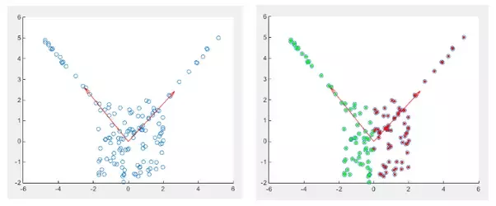
Cosine Similarity Analysis: Overview
Advanced NLP Analysis
Cosine Similarity is a common analysis used to determine the similarity between two vectors.
Objective
Calculate cosine similarity of each city policy with the "ideal" policy using the 7 calculated dimensions
Assumptions
Word frequency can quantify a policy’s coverage of use of force
The "ideal" policy can be represented as a vector where each value is the max column-wise value
Source: https://www.quora.com/When-should-I-use-cosine-similarity-Can-it-be-used-for-clustering
Notes:
David

Slide 11
Cosine Similarity Analysis: A Deeper Look
Advanced NLP Analysis
The team identified seven policy areas, and associated words with each respective policy area, to define our cosine similarity analysis.
Policy Area
Sample Words
 | Chokehold Ban – Being proactive in banning violence | Chokehold, trachea, throat, suffocate
 | De-escalation – Finding peace in stressful situations | Mediation, preparation, training, persuasion
 | Reporting – Transparency → Proactiveness | Document, summary, comprehensive, data
 | Intervention – Breaking bystander barriers | Intercede, bystander, negotiation, disengagement
 | Use of Tech – Innovative policing methods | Digital, Mobile, computer, electronic
 | Violence Policy – Comprehensiveness → Protection | Assault, violent, danger, harm
 | Moving Vehicle – Calling out difficult to ascertain situations | Vehicle, driving, car, passenger
7
POLICY
AREAS
Notes:
David

Slide 12
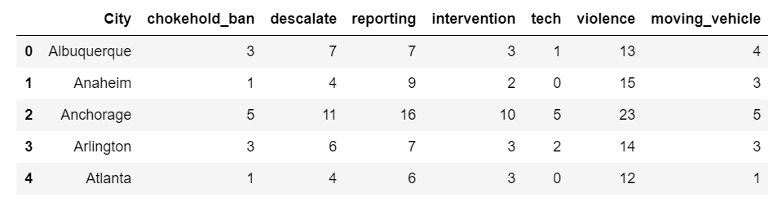
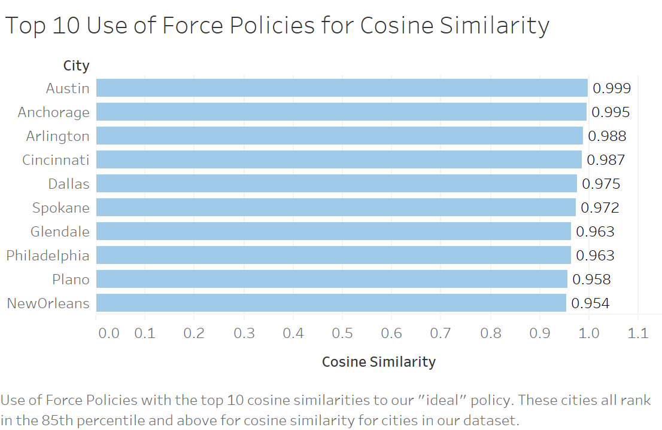
Cosine Similarity Analysis: Outputs
Advanced NLP Analysis
By counting the word frequencies of the various policy areas, we were able to calculate the top ten most similar use of force policies to the "ideal" policy.
Notes:
David

Slide 13
Cosine Similarity Analysis: Top 10
Advanced NLP Analysis
Cosine similarity was calculated by comparing the "ideal" policy, defined by calculating the maximum value for each respective policy area, to each respective policy. These were the “top” 10 policies.
Notes:
David

Slide 14
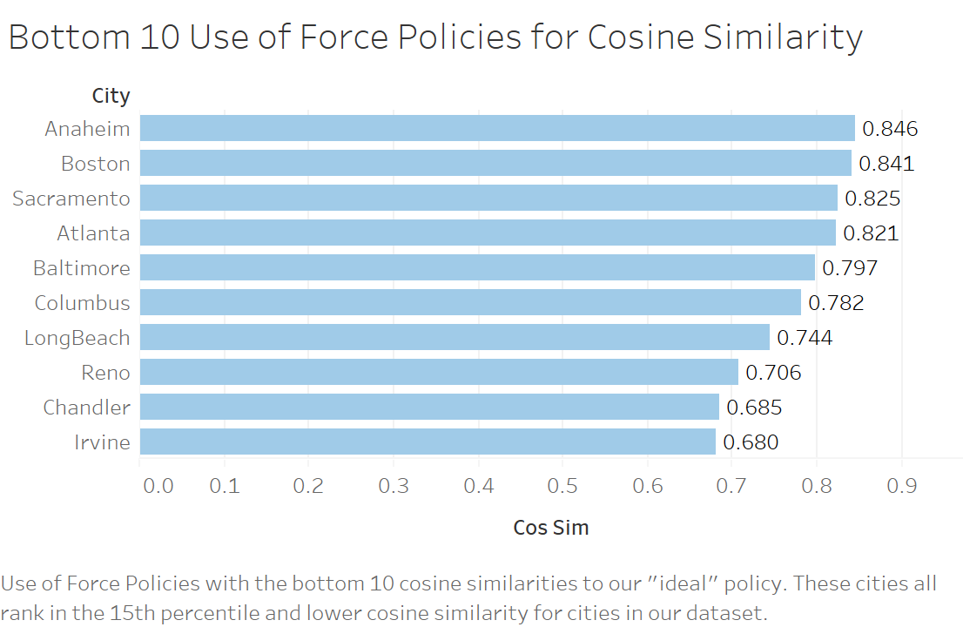
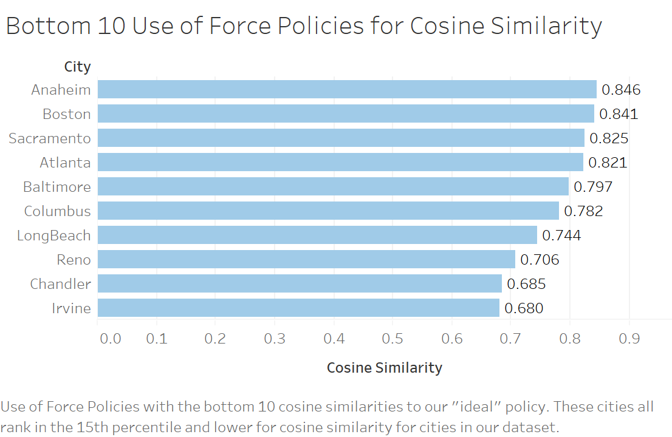
Cosine Similarity Analysis: Bottom 10
Advanced NLP Analysis
Cosine similarity was calculated by comparing the "ideal" policy, defined by calculating the maximum value for each respective policy area, to each respective policy. These were the “bottom” 10 policies.
Notes:
David

Slide 15
Questions?
Notes:
Kennedy

Slide 16


Implications: What's Next?
NEXT STEPS
Model implications and next steps to continue the analysis with additional time/scope.
Model Use Cases
Model Constraints
Local officials updating use of force policies can quickly filter to see if critical elements to reduce violence are included
Expand geography to see how additional Use of Force policies across the U.S and the world compare to the "ideal" policy
Analyze model outputs in comparison to violence data to continue the research on reducing police violence
With more time, additional constraints to address include:
Scraping additional pdfs with nuanced formatting
Refining ability to detect each key policy
Testing and comparing model outcomes to Campaign Zero research conclusions
Notes:
Kennedy

Slide 17
Appendix

Slide 18
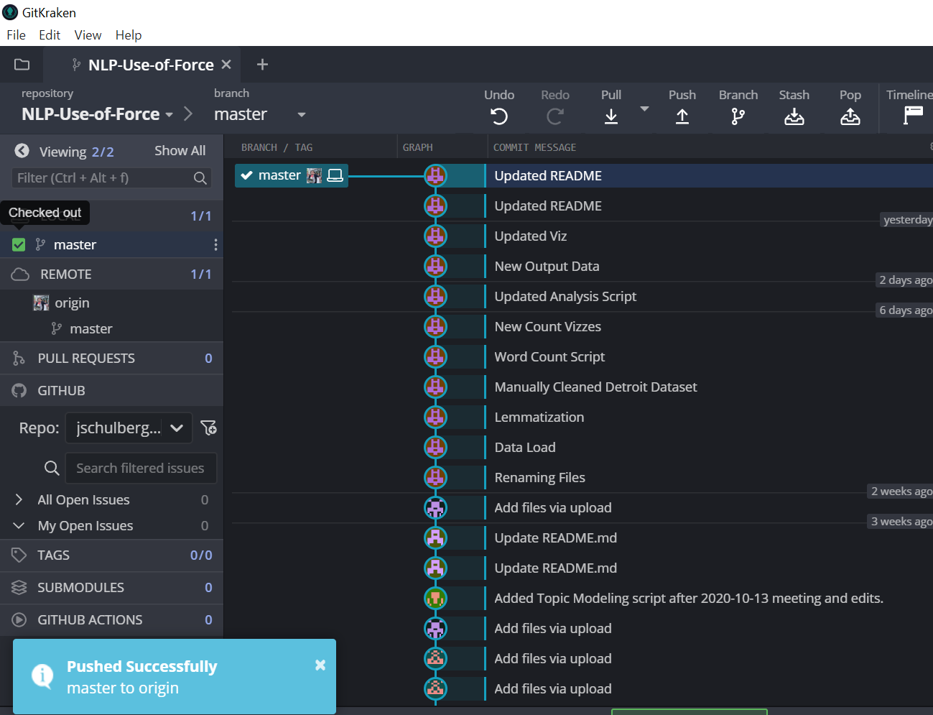
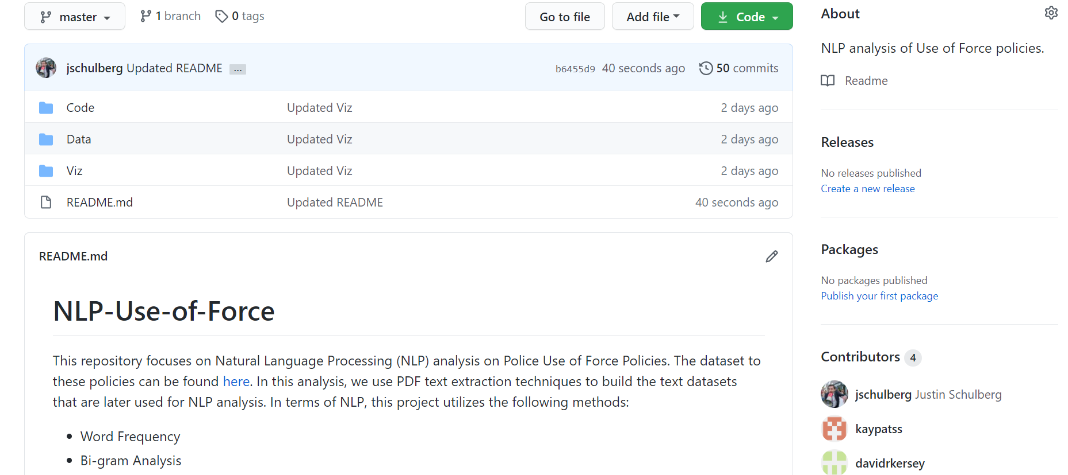
Code Management: GitHub + GitKraken
APPENDIX
Our team used GitHub and GitKraken to ensure code management best practices, including code versioning, file storing, and readability.
Check us out! (And hit us with the follow)
https://github.com/jschulberg/NLP-Use-of-Force
Notes:
David

